Slide 1



The Model of the Atom
www.utoronto.ca
www.sparknotes.com

Slide 2
What Does an Atom Look Like?
The question was asked by many scientists at the turn of the century.
Electron discovered by J.J. Thomson (1897).
Scientists generally agreed that the atom was a basic building block that all matter was comprised of.
An atom could not be an indivisible particle (We know today that that is NOT the case).

Slide 3
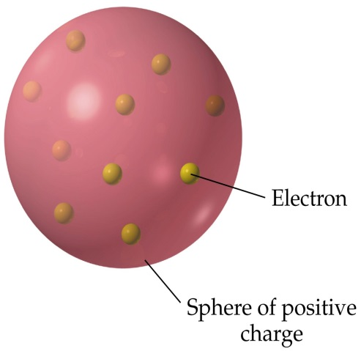
J.J. Thompson (1898)
Predicted that there were massive positively charged particles in the atom that were offset by much smaller negatively charged particles.
Negatively charged particles were distributed throughout a sea of positive charge such that they offset one another.
His model was known as the plum-pudding model.
wps.prenhall.com

Slide 4
Earnest Rutherford (1911)
“The Gold Foil Experiment”
Bombarded gold foil with α particles from the radioactive decay of uranium₂₃₈.
Most of the particles traveled through very thin gold foil without being deflected.
Occasionally, particles would deflect, sometimes at angles > 90º (due to a coulombic repulsive force).
Results show that the dense positive charge is centrally located in the nucleus.
His model is know as the nuclear model and disproved Thomson’s theory.

Slide 5
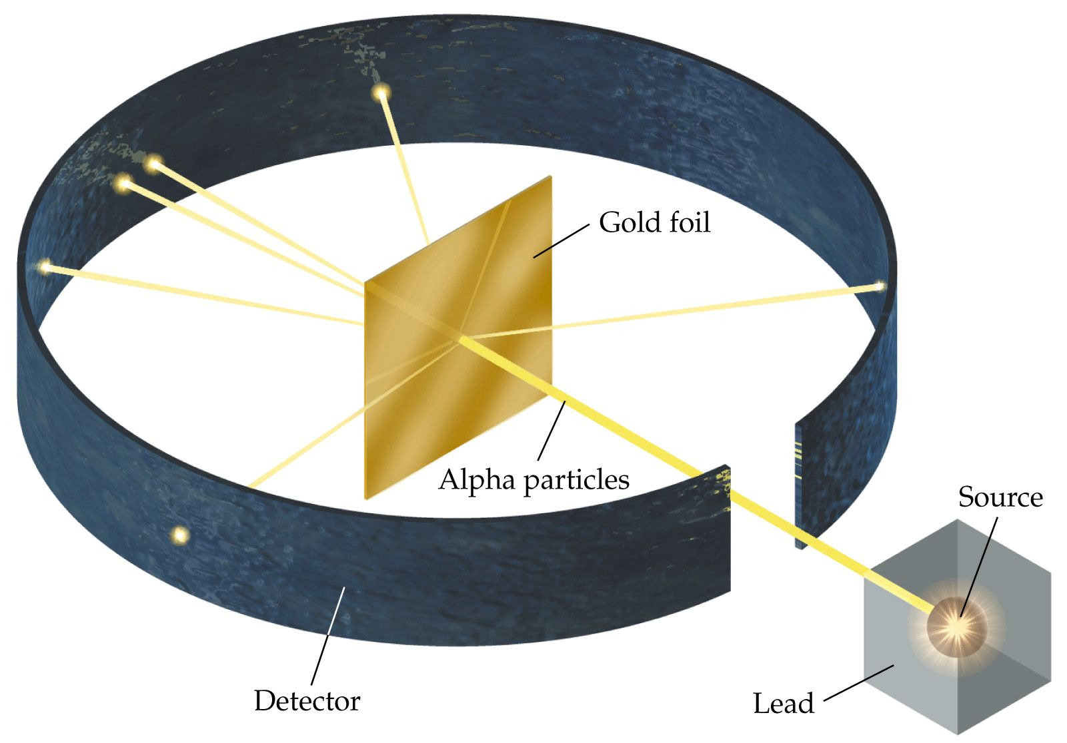
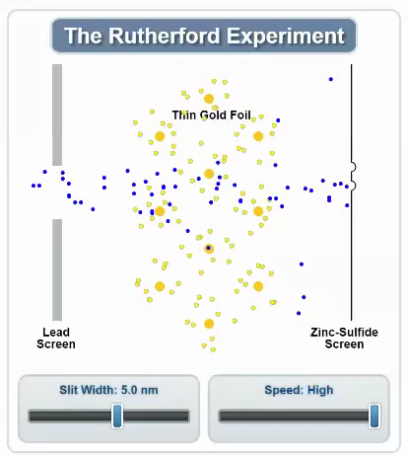
The Gold Foil Experiment
Rutherford's Gold Foil Experiment
wps.prenhall.com
Note: The diameter of the atom was determined to be on the order of 100,000x larger than the nucleus!

Slide 6
Neils Bohr (1913)
Assumed the laws of electromagnetism do not apply inside an atom. Consequently, an orbiting electron would not lose energy even though it is accelerating.
Only certain orbital radiuses are possible for an electron, representing an energy state (mvr = nh/2π).
Energy is emitted or absorbed when electrons change from one discrete energy level to another.
  Energy levels are consistent with Einstein’s theory on the photoelectric effect where he said that photons have discrete amount of energy (E = hf).

Slide 7
Key aspects of the Bohr Model of the Atom
Atoms have discrete energy levels associated with changes in location of electrons within the atom.
  The lowest energy level is called the “ground state” (All electrons are in their proper orbitals).
  When an atom is not in the ground state, it is considered to be in an “excited state”.
  When an electron absorbs energy from a photon of light, it can transition to another discrete energy level if the energy of the photon is exactly equal to the difference in energy levels.
  Orbits near the nucleus have less energy than those farther out because it takes more energy to move an electron further away.
  Note: An atom is in the excited state for a very short period of time (~10⁻⁹ sec.)!

Slide 8
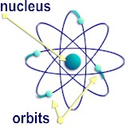
The Bohr Model of the Atom
The Bohr model of the atom is commonly called the “planetary model”.
Electrons travel in well defined orbits around the nucleus of the atom.

Slide 9
Einstein & Bohr’s Theories Combined (The Bohr Radius)
In the Bohr model, the centripetal force of the electron is offset by the electrostatic force.
F_{c} = F_{e}
m_{e}v² kq²
r r²
Bohr said that the angular
momentum of the electron
is quantized as follows.
L_{n} = m_{e}v_{n}r_{n} = nh/2π (2)
Coulomb’s Law
= (1)
v
-
F_{c}
+

Slide 10
Einstein & Bohr’s Theories Combined (The Bohr Radius)
Solving (2) for v_{n} and substituting into (1) results in:
h² n²
4π²m_{e}kq² Z
E = KE + EPE
E = ½m_{e}v² - kq²/r = -½kq²/r (4)
Substituting (3) into (4) yields:
2π²m_{e}kq⁴ Z²
h² n²
Substituting for m, k, h and q yields:
E_{n} = (-2.18 x 10⁻¹⁸ J)•Z²/n² or E_{n} = (-13.6 eV)•Z²/n²
r_{n} = n = 1, 2, 3, … (3)
Atomic
Number
v
-
F_{c}
+
E_{n} = (5)

Slide 11
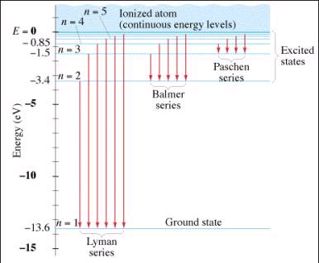
The Bohr Model – Energy Level Diagram for Hydrogen
To energize an electron from the ground state to n = ∞, 13.6 eV of energy must be supplied.
Energy required to remove an electron is called the ionization energy.
Energy levels get closer together as they approach the ionization energy.
Visible
Light
www.physics.usc.edu
Increasing λ
Decreasing Energy

Slide 12
Bohr Model and Emission Spectra
Bohr’s theory for the structure of the atom took into consideration Einstein’s theory of photons and energy as a means to explain why Hydrogen emits only four different wavelengths of visible light.
Bohr’s model predicts that photons of energy will be emitted in the form of EMR when an electron transitions from a higher energy level to a lower energy level.
-
Photon emitted contains a discrete amount of energy that is specific to the transition.
E_{i} – E_{f} = hf
E_{i} – E_{f} = hc/λ
-
+
E_{f}
E_{i}
Bohr Atom and Emission of Light

Slide 13

Visible Spectrum of the Hydrogen Atom
The photons of light emitted when going from any energy level to the ground state emit EMR in the ultraviolet region.
The photons of light
emitted when going from
other energy levels to the
2nd energy level will emit
light in the visible light
region.
n=5
n=4
n=3
n=2
+
n=1
Red
655nm
blue green
485nm
Dark Blue
433nm
Violet
409nm

Slide 14
The Energy Levels of the Hydrogen Atom (The Well)
In order for an electron to change from a lower energy state to a higher energy state, the incident photon must have the exact amount of energy equivalent to the difference in energy levels of the hydrogen atom.
E_{photon} = E_{i} – E_{f}
For example: an electron transitioning from the ground state (n=1) to a higher energy level (n=2) requires a photon of 10.2eV.
  What would happen if a photon had only 10eV of energy of energy?
    NOTHING!

Slide 15
Quantization of the Energy Levels of the Hydrogen Atom
E_{photon} = E_{i} – E_{f}
In order for an electron in a hydrogen atom to transition from n=1 to n=3 it needs a photon with exactly 12.09eV (13.60eV – 1.51eV) of energy.
  How will it return to the ground state?
When transitioning back to the ground state, the electron can take one of 3 possible transitions: 3 – 1, or 3 – 2 followed by 2 – 1.
  Each jump would emit a photon with an amount of energy equal to the difference between the two energy levels.

Slide 16
Problems with the Bohr Planetary Model
The Bohr model of the atom works for Hydrogen, but not for other elements.
Bohr could not explain the conflict between acceleration of a charged particle (e⁻) and the production of EM radiation that would lead to the collapse of the atom.
Bohr could not explain the reason for quantization of angular momentum.

Slide 17
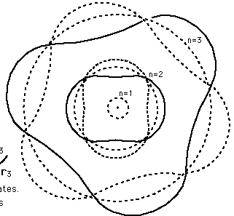
Angular Momentum Solved
Bohr proposed that the angular momentum is quantized.
L_{n} = mv_{n}r_{n} = nh/2π (1)
But why should L_{n} be limited to values of h/2π?
Louis de Broglie proposed that particles travel in waves, even in their orbits.
Electrons traveling in orbits
create standing waves
superimposed on a Bohr orbit.
Since λ = h/mv (2)
Where λ = de Broglie wavelength
Substituting (2) into (1) yields nλ = 2πr
Particle-Wave Applet

Slide 18
Quantum Model (Heisenberg Uncertainty Principle) - 1926
Erwin Schroedinger and Werner Heisenberg developed a theoretical framework that established a new branch of physics called quantum mechanics.
Their theories explain the probability of determining a particle’s position and momentum at the same time.
  Δy=uncertainty of a particle’s position in the y-direction
  Δp_{y}=uncertainty of the y-component of linear momentum
  Note: it is not possible to determine the position and momentum of an electron at the same time!

Slide 19
Quantum Model (Heisenberg Uncertainty Principle) - 1926
The quantum model predicts the “probability” of finding the electron around the nucleus of a atom.
The probability of finding an electron is its highest in a region called the electron cloud.
Electron Cloud
www.sparknotes.com

Slide 20
Key Ideas
The atom is defined as a probability cloud of electrons with a centrally located nucleus.
The nucleus is fractionally smaller compared to the entire atom (1/100,000th).
J.J. Thompson developed the first working model of the atom – the plum-pudding model.
Earnest Rutherford developed the nuclear/planetary model of the atom as a result of the gold foil experiment.
Neils Bohr further developed the planetary model of the atom and solved many questions about the hydrogen atom.

Slide 21
Key Ideas
The Bohr model of the hydrogen atom contains electrons which orbit the nucleus in orbits that are associated with discrete energy levels.
Erwin Schroedinger and Werner Heisenberg developed the quantum model of the atom with the wave-particle theory.
An electron in any state other than the ground state is said to be excited.
When an electron transitions from an excited state to the ground state, it will emit a photon of light and vice-versa when going from the ground state to an excited state.

Slide 22
Problems with the Nuclear Model
Electrons are under constant acceleration due to centripetal motion.
It was then reasoned that they must be giving off EM radiation.
Conservation of energy then suggests that the electrons would eventually spiral into the nucleus.
In addition, as the electrons got closer to the nucleus, their speed would increase as would the frequencies of emitted radiation, covering a broad range of the EM spectrum.

